Slide 1
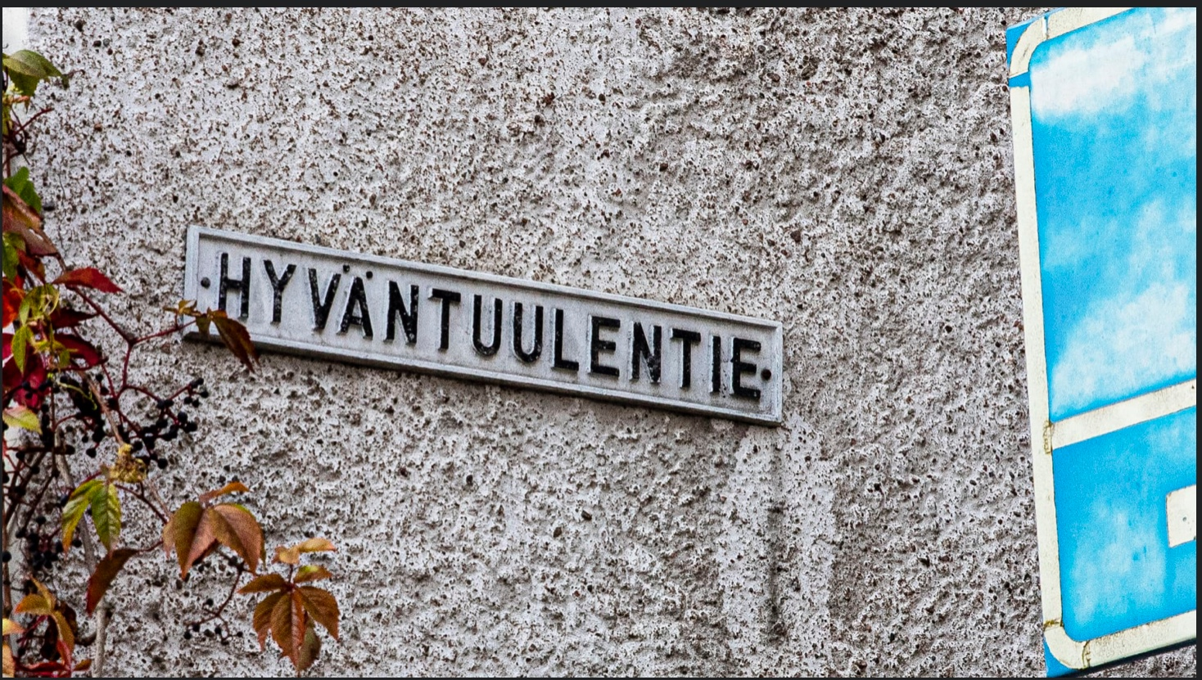
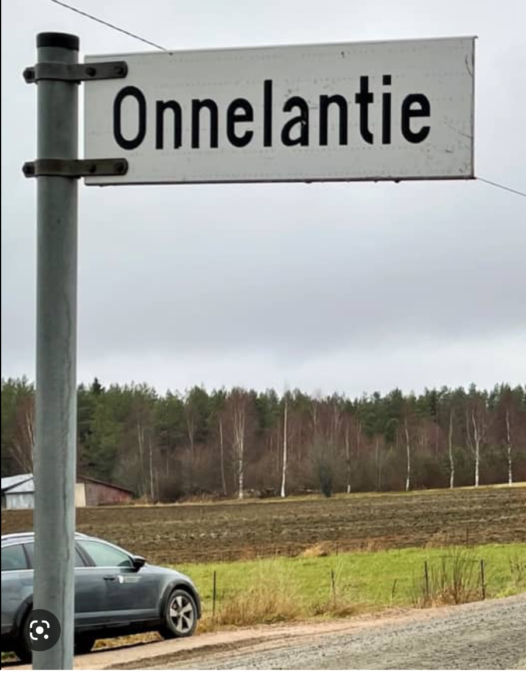
Get to know Finland
15.6.2023
12:30 – 14:00

Slide 2
Assignment 1: Presentation due 19.6.
MyCourses (instructions):
Choose a topic and write your name and your presentation's topic after the theme in MyCourses.
1. History (a person, an event, an era..):
2.Geography (national Landscape(s), nature, places..):
3. Art and architecture (music, arts, film, literature..):
4. Technology:
5. Business (game industry, design..):
6. Culture (sauna, food, sports..):
7. Your own idea (please give the topic):

Slide 3
Assignment 3: Cross-Cultural journal due 20.6.
Instructions:
You have two options (choose either A or B, not both):
Write an essay about the things you have learned about Finnish lifestyle, culture, history, society, communication etc.
B. Write a description and analysis on some event/situation you saw or experienced in Finland.

Slide 4
Assignment 2: City Tour due 25.6.
MyCourses (instructions): on your own time
Choose 5 places to visit from the list given. If you start from the Railway station, you could follow the order the places are listed here.
2. The idea is that you read the introductions in the quiz and do the tasks while you are on site. You need The Quick Response (QR) code to listen to the audio of the statues. If the QR-code is not functioning, watch the video in The Statue talks to you instead.
3. Submit your answers 'Preview the quiz' and indicate all the participants.
You take the tour whenever you want and submit your answers by the deadline date. You can do the tour alone, with a pair or with a group, it is up to you. Pay attention to the opening hours. Enjoy the architecture and have fun!

Slide 5
Assignment 2: City Tour due 25.2.
City Tour List:
1. The Railway Station 2. The Senate Square and Alexander II statue 3. The Helsinki Cathedral 4. Uspenski Cathedral 5. Esplanade Park, Havis Amanda statue and Kappeli restaurant 6. Oodi Central library 7. Kiasma The Museum of Contemporary Art 8. The Glass Palace in Kamppi district 9. The Chapel of Silence in Kamppi 10. Temppeliaukio Church

Slide 6
Assignment 2: City Tour due 25.6.
Please note:
Answer the questions directly in the quiz session
(+ upload your photos, if you can)
If not: upload your photos-> Submit your city tour here (assignment box)

Slide 7
Lesson 4: Finnish society and education
Today we will discuss..
… Finland as the happiest country in the world
… Finnish education

Slide 8
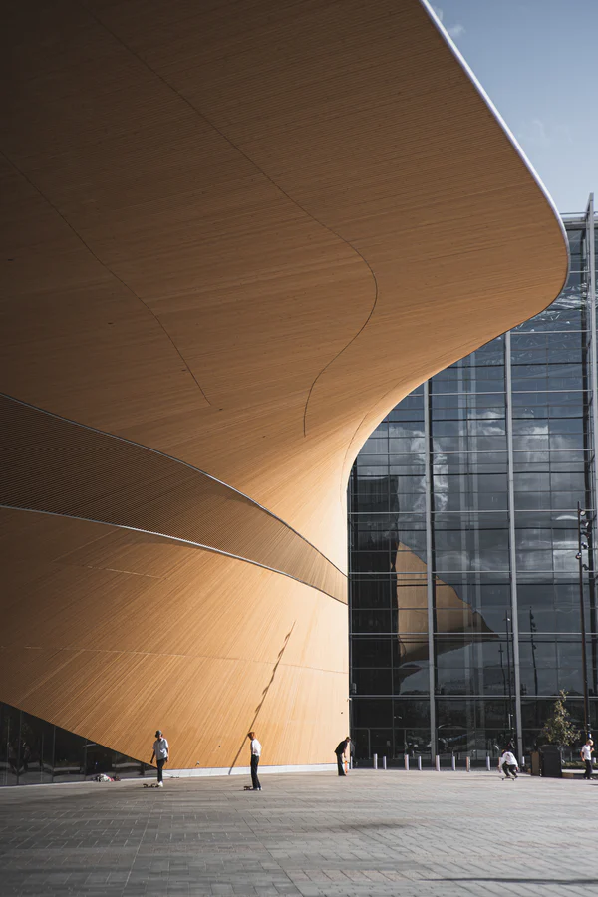
Finland – a welfare system
First steps into building Finland a Nordic welfare system were taken after 1952 when Finland paid the last war reparations to the Soviet Union
The economy started to grow, and the state began to collect more taxes
What is a Nordic welfare system?
The state evens income differences with progressive taxation
The state secures sufficient income and basic services, such as health care and education, to everyone
Some major steps that have strengthened the welfare system:
Health insurance to all in the 1960s
Free education to all in the 1970s
Daycare place to all children in the 1970s → this allowed women to more easily take part or return to working life; How has Gender Equality Shaped Finland?
Politics nowadays: lighter taxation in certain areas, a growing private sector

Slide 9
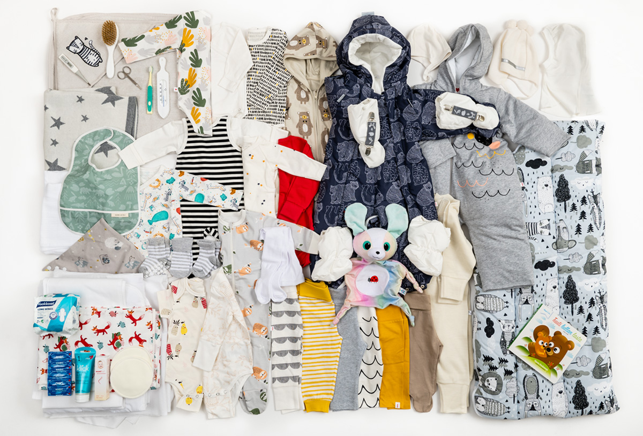
Finland – a welfare system
Äitiyspakkaus maternity package
1937 to disadvantaged mothers (to bring them into social security system)
1949 to all mothers

Slide 10
Finland: the happiest country in the world
United Nations World Happiness Report 2023: Finland is the happiest country in the world for the 6th year in a row!
Finland, with a score of 7.82 out of ten, is ahead of Denmark, Iceland, Switzerland and the Netherlands, which are next on this list.
Some things that are taken into account in the report: GDP, health, corruption, social networks, feelings of joy or happiness, trust in the society
Finland “Happiest Country In The World” For 6th Consecutive Year - YouTube
Video: Is Finland really the happiest country in the world?

Slide 11
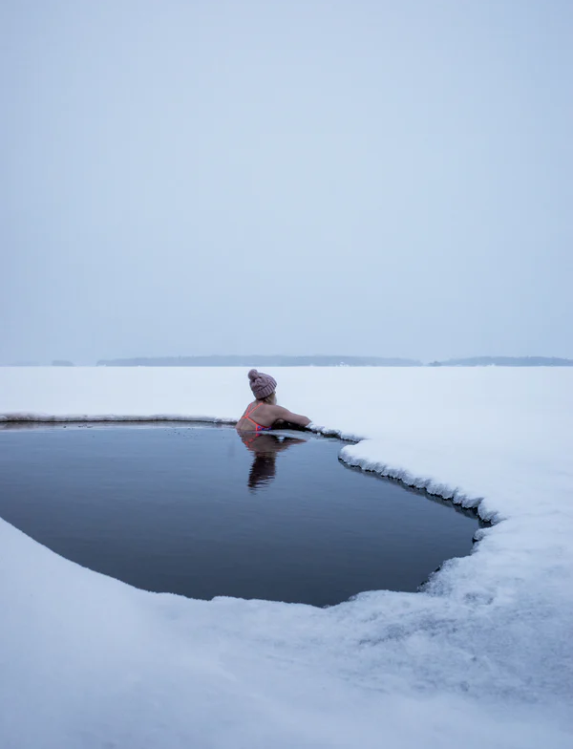
Finland: the happiest country in the world
Group discussion:
What makes a happy country?
Discuss based on the pre-task video and the video watched now.
Do you agree or disagree with the videos?
What makes you happy as a citizen?

Slide 12
Finland: the happiest country in the world
According to the World Happiness Report 2021, confidence in institutions was one of factors that supported successful COVID-19 strategies (World Happiness Report 2021, https://happiness-report.s3.amazonaws.com/2021/WHR+21_Ch1.pdf)
“Finland has always ranked very high on the measures of mutual trust that have helped to protect lives and livelihoods during the pandemic.” (In article “In a Lamentable Year, Finland Again is the Happiest Country in the World”, 2021: https://worldhappiness.report/news/in-a-lamentable-year-finland-again-is-the-happiest-country-in-the-world/)
“Trust and the ability to count on others are major supports to life evaluations, especially in the face of crises. To feel that your lost wallet would be returned if found by a police officer, by a neighbour, or a stranger, is estimated to be more important for happiness than income, unemployment, and major health risks.” (World Happiness Report 2021, https://happiness-report.s3.amazonaws.com/2021/WHR+21_Ch1.pdf)

Slide 13
Finland: the happiest country in the world
Happy or just content?
Trust in society: social trust, trust in the government
Welfare system
Safe environments
Healthy life

Slide 14
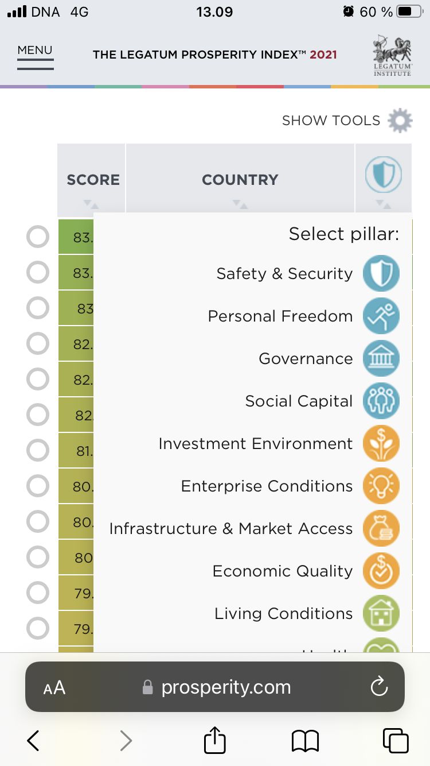
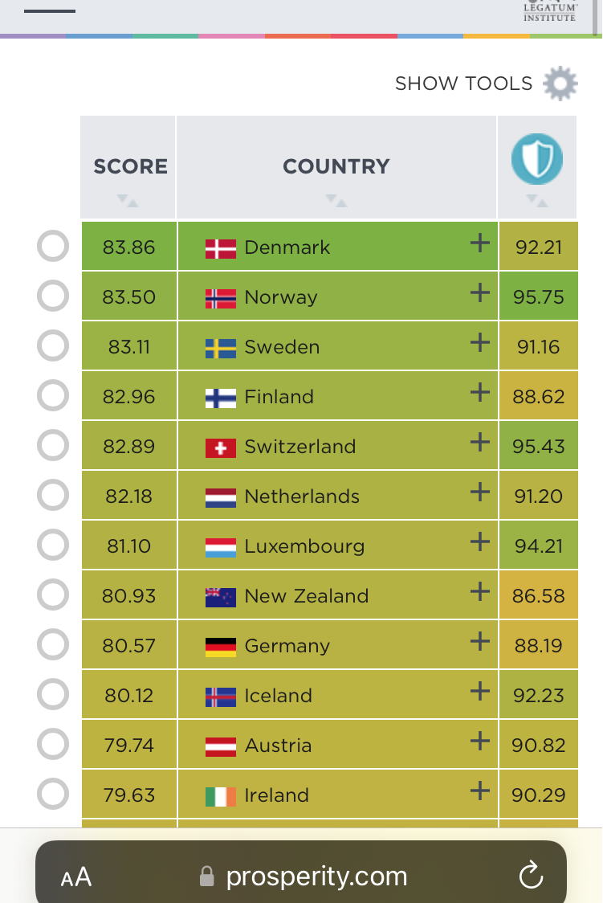
Finland: the happiest country in the world
The Legatum Prosperity Index: A tool that offers insight to how prosperity forms and changes in 167 countries across the world
Group work: See the ranking and the pillars and compare Finland to a few other countries. How is Finland positioned in the ranking based on different pillars? Which pillar(s) do you find (the most) important in a society? Why?
Rankings :: Legatum Prosperity Index 2021

Slide 15
Finland: the happiest country in the world (?)
Finnish institute for health and welfare (Sep 5, 2018): “Alcohol consumption in Finland has decreased, but over half a million are still at risk from excessive drinking.”
Alcohol consumption in Finland decreased to lowest in the 2000s in the first year of the pandemic (2020)
Suicide rates by country 2022: Finland 25th in the listing
Negative effects of the pandemic: unemployment, mental health issues, wellbeing, polarization in the society, ill-being/mental disorders/unhappiness among children and adolescents
Demographic segregation has increased

Slide 16
FINNISH EDUCATION

Slide 17
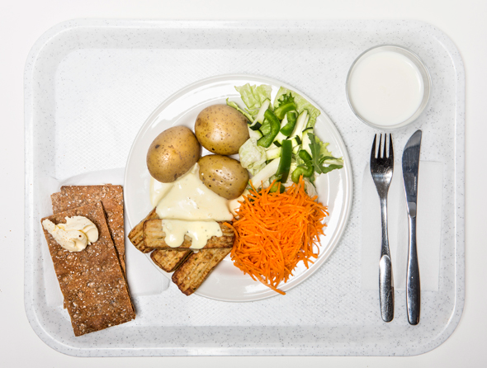
Finnish education
In Finland school meals are free for children / students from pre-school to second degree studies (vocational and high school).
Finland was the first country to enact the law for free school meals (in 1943).

Slide 18
Finnish education
Teacher education: all teachers hold a Master’s degree
Teacher education is competitive: In 2020 apr. 8 % of the applicants were accepted into the teacher education at the University of Helsinki
Video: Pasi Sahlberg, PhD: What can we learn from Finnish education system? 38.40-42.05
But: 6 out of 10 teachers are considering career change (OAJ 2021 https://www.oaj.fi/en/news/news-and-press-releases/2021/alanvaihtokysely-09-21/)
Reasons: increased workload, wages, poorly implemented inclusion
The number of teachers considering career change has increased during the pandemic

Slide 19
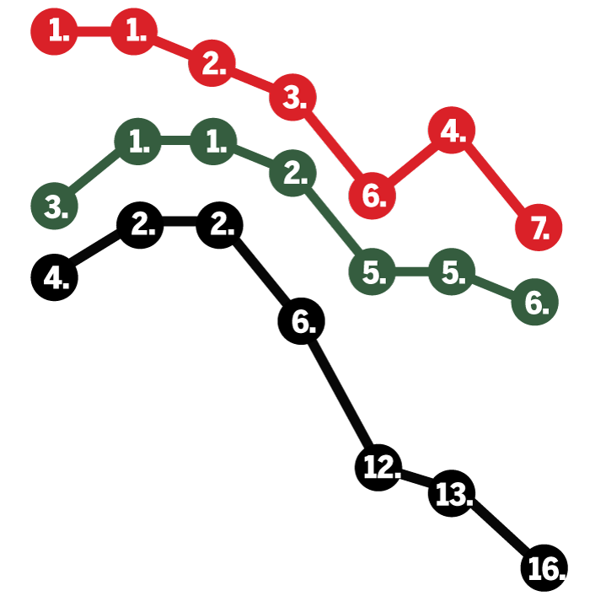
Finnish education
OECD: PISA (Programme for international student assessment in reading, mathematics, and science):
Finnish children performed 7th best in the latest Pisa study (2018)
Results have however lowered in natural sciences, reading as well as in mathematics throughout the 21st century
Finnish children’s literacy is among the best in the OECD countries, but differences in literacy skills between boys and girls is growing
But: Finnish children are both knowledgeable and happy according to the latest study (which is rare compared to other OECD countries)
→ “There is more to life than school”
reading
natural
sciences
mathemathics
Opetus- ja kulttuuriministeriö; Karut luvut paljastavat, että jotain on nyt pielessä – mitä tapahtui Suomen kouluille? - Kotimaa - Ilta-Sanomat

Slide 20
Group Discussion:
Discuss the Finnish education system based on the pre-tasks, today’s material and a PDF file “Finnish education system” in the course page.
Discuss e.g.:
What do you find interesting?
What are the key values of the Finnish education system?
What is similar or different to schools that you have gone to? (E.g. public / private school division, teacher education, amount of homework..)

Slide 21
Finnish education: Top 5
Creativity
Linguistically responsive teaching,
multidisciplinary projects part of the core curriculum
The overall freedom of teachers
Teaching based on strengths
Students as co-partners
(active participation in decision making)

Slide 22
Pre-tasks for lesson 5
Fifth and last lesson already next Friday!
1. Be prepared to give your presentation in small groups! ☺
2. Finland Toolbox: Creative Finland. Skim through the brochure on creative industries in Finland.
Concentrate on what interests you the most and take some notes:
Did you already know something about the creative industries in Finland? What?
What did you find especially interesting in the brochure? Why? What kind of an image does it give of creative industries in Finland? What is your relationship to different forms of art?
3. Add a picture / link / video that has something to do with the Finnish creative industries to the discussion forum in MyCourses.
It can be anything about Finnish art, music, fashion… (e.g. a picture of a piece of art or a link to Finnish music video.)

Slide 23
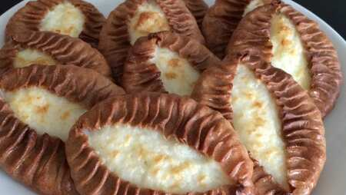
Hyvää loppuviikkoa!
Nähdään taas!

