Slide 1
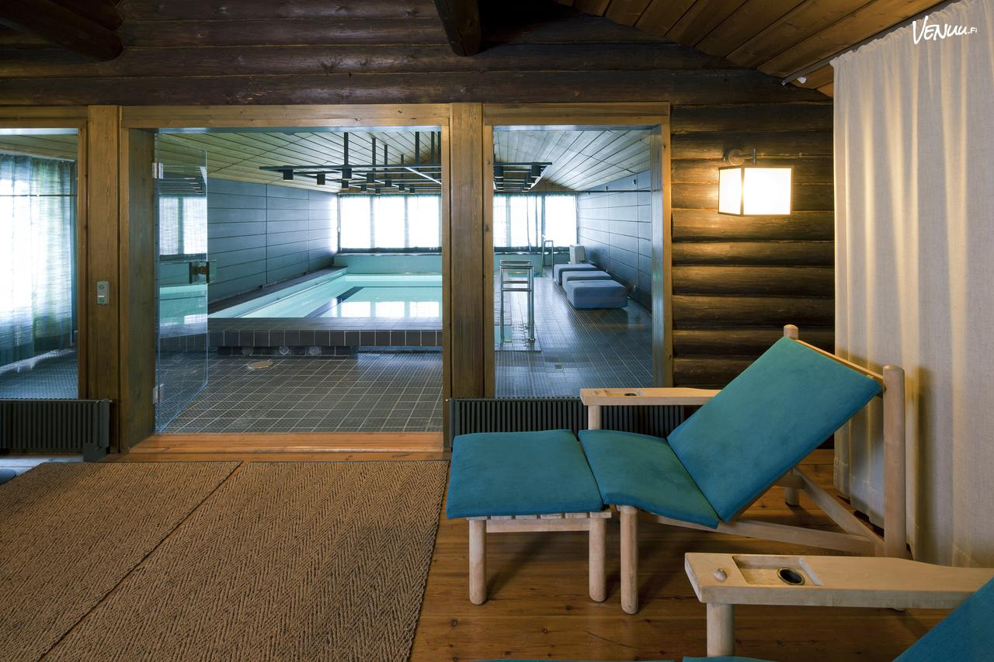
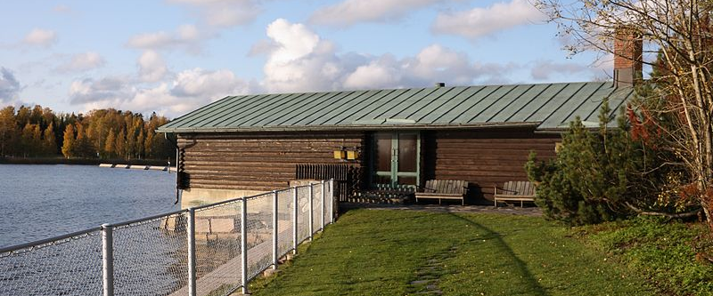
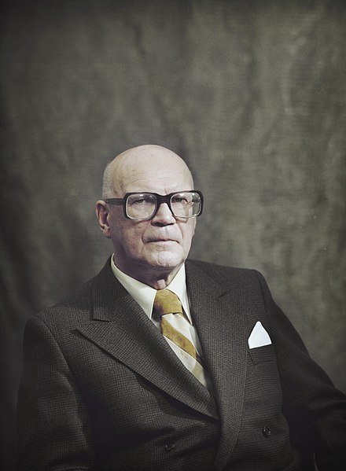
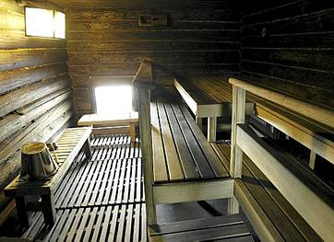
Get to know Finland
12.6.2023
12:30 – 14:00

Slide 2
Assignment 1: Presentation due 19.6.23
MyCourses (instructions):
Choose a topic and write your name and your presentation's topic after the theme in MyCourses.
1. History (a person, an event, an era..):
2.Geography (national Landscape(s), nature, places..):
3. Art and architecture (music, arts, film, literature..):
4. Technology:
5. Business (game industry, design..):
6. Culture (sauna, food, sports..):
7. Your own idea (please give the topic):

Slide 3
Assignment 3: Cross-Cultural journal due 20.6.
MyCourses (instructions):
You have two options (choose either A or B, not both):
A. Write an essay about the things you have learned about Finnish lifestyle, culture, history, society, communication etc.
Consider your own experiences and things that we covered during the course. You can focus on the aspect(s) of the Finnish culture/society that you find the most interesting. You can also compare your current knowledge to the knowledge you had before coming to Finland. How have your feelings, ideas or thoughts about Finland changed so far? Write 250-300 words.

Slide 4
Assignment 3: Cross-Cultural journal due 20.6.
OpenLearning (instructions):
B. Write a description and analysis on some event/situation you saw or experienced in Finland.
First describe what you saw or experienced (anything that strikes you as different, funny, weird, sad, good, etc.). Then describe your thoughts, feelings, opinions etc. about the event. Try to analyze why you feel/think this way. How do you think your own cultural background affects on how you feel? Also try to figure out why Finns behaved the way they did in the situation you described: how would you analyze the situation based on your cultural competence.
Write 250-300 words.

Slide 5
Lesson 3: The Finnish way of life
Today we will discuss..
… some habits and ways of doing things in Finland
… Finland as a society of trust
… Finland as a Nordic welfare system

Slide 6
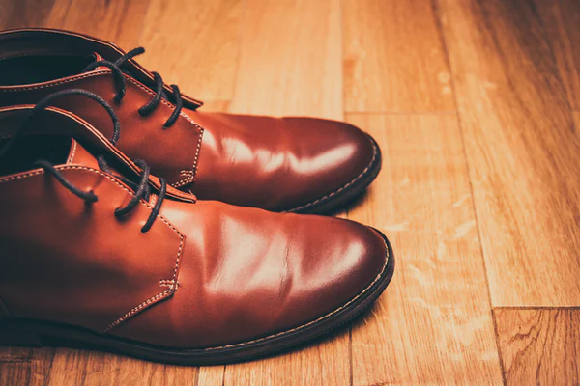
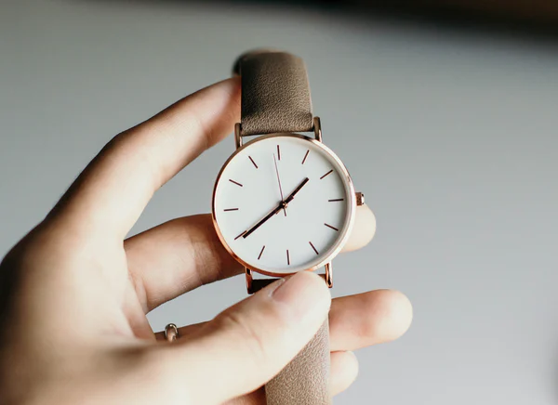
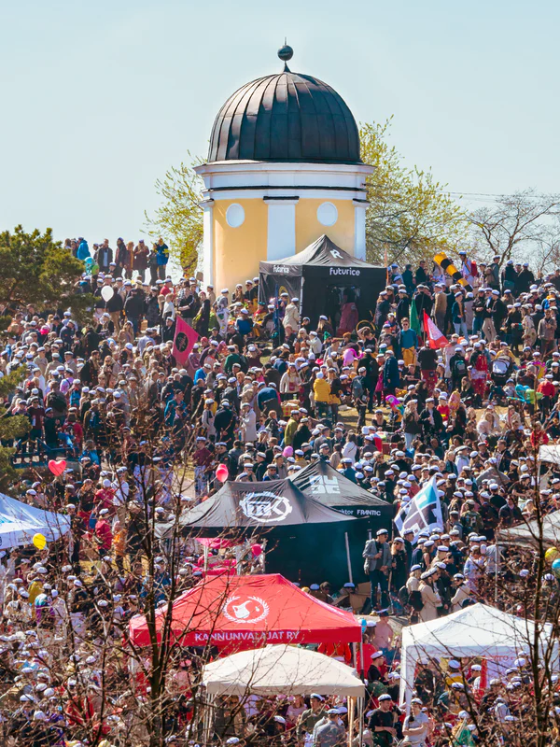
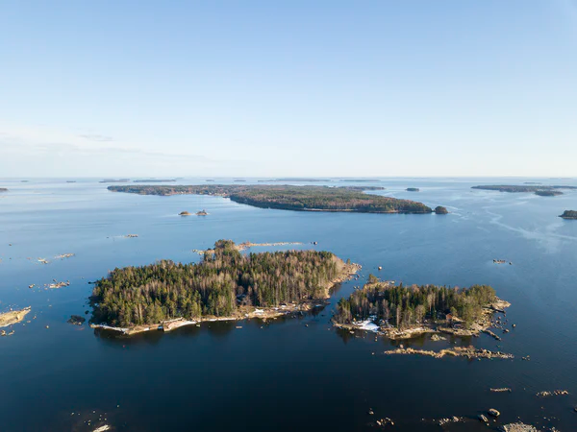
The Finnish way of life: (some) Finnish customs and manners
no shoes
at home
+ Visiting someone’s house usually means that you..
.. help yourself!
.. BYOB.
(You might be invited to sauna as well. ☺)
punctuality
student life
equality
low hierarchy
nature

Slide 7
The Finnish way of life: (some) Finnish customs and manners
Present your topic to your group (max 2 min per person) and discuss:
What did you find the most interesting?
What did you find similar/different to your daily life or to your culture?
What kind of Finnish customs and manners have you encountered so far?

Slide 8
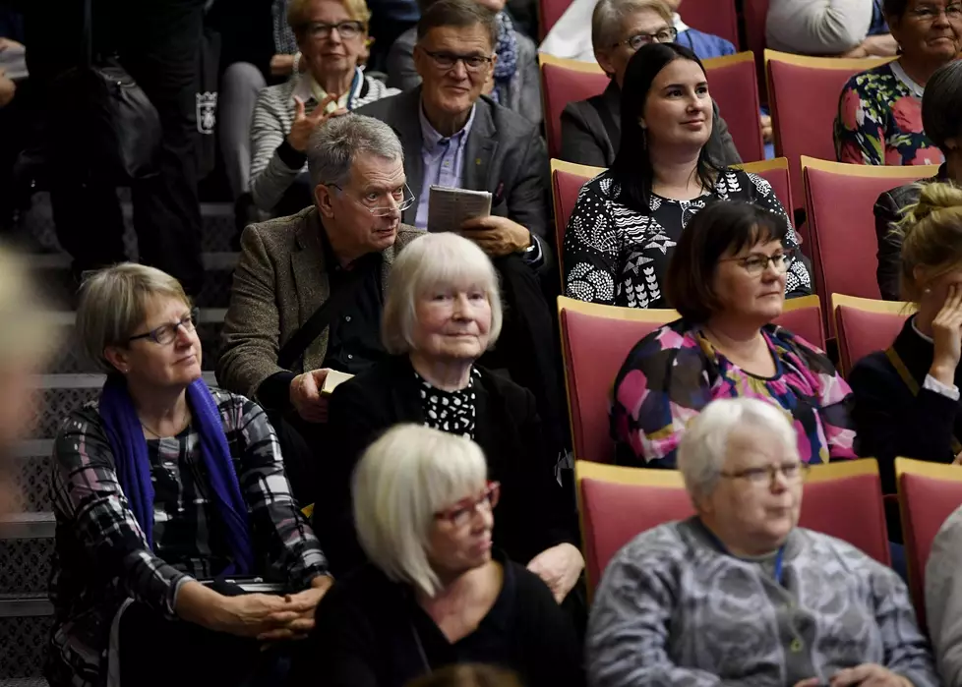

Slide 9
Finland: a society of trust
Eurobarometer 2021
What do Finnish people have trust in?
91 % trust in the police (compared to EU27: 69 %)
80 % trust in judicial system
76 % trust in the written press
63 % trust in the government (compared to EU27: 36 %)
50 % trust in the EU (compared to EU27: 49 %)
10 % trust in the social media
(https://ec.europa.eu/finland/sites/default/files/eb94_nat_fi_fi.pdf)
Eurobarometer 2018: Finns are the most trusting people in Europe
“From north to south”: From trusting other people to trusting “only” family members
“In the Nordics, high levels of trust can be explained by a welfare model based on equality and a universal right to basic services. This prevents “us” vs “them” division from forming.” Maria Bäck, Political researcher at Åbo Akademi. (YLE News 23.6.2018.)

Slide 10
Finland: a society of trust
“Rally round the flag” phenomenon during the early months of the pandemic in 2020 → trust in political decision-makers grew
What creates trust in the society?
If institutions trust people, people trust institutions – and other people as well
High levels of social security increase trust: people are treated equally and fairly
Welfare system enables and supports the citizens’ participation in social life
Social capital: network of relationships that create trust and reciprocity; shared sense of identity, norms, cooperation
Equal school system
(https://www.helsinki.fi/fi/uutiset/talous/suomalaiset-luottavat-yha, https://www.eva.fi/blog/2021/06/08/pandemiassakin-suomalainen-luottaa-presidenttiin-poliisiin-ja-puolustusvoimiin/)

Slide 11
Finland: a society of trust
Group discussion: Share your thoughts on trust!
Would you trust a stranger or is it “better to be safe than sorry”?
How would you describe trust in society in places you have lived in compared to Finland?
Discuss based on today’s material and the examples in the pre-task text: 1) having somebody return your lost valuables, 2) independence of children at early age,
3) following rules, 4) trusting different institutions,
and 5) corruption.

Slide 12
Finland: a society of trust
Transparency International 2021: Finland is the least corrupt country in the world together with Denmark and New Zealand
Corruption in Finland is more structural and harder to detect
It ofter occurs at the interface between business and public authorities
Corruption takes the form of giving and taking unfair advantages, conflicts of interest and favouritism
”good brother” network

Slide 13
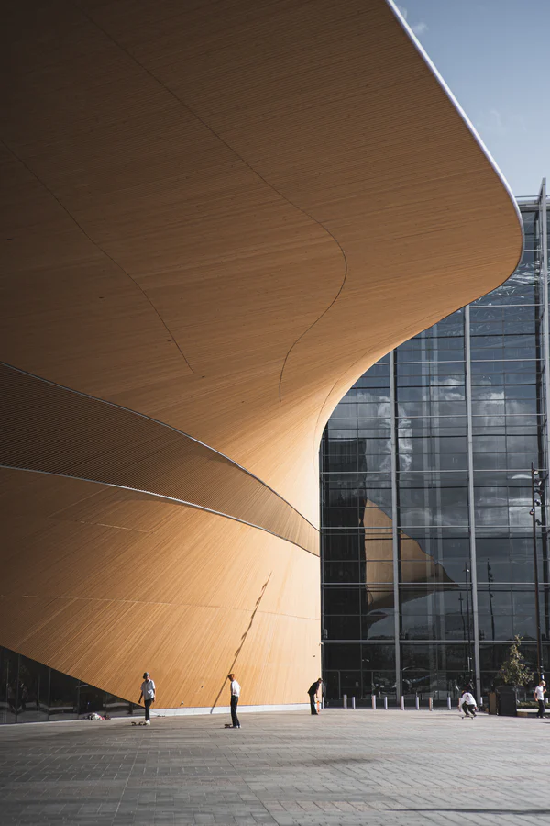
Finland – a welfare system
First steps into building Finland a Nordic welfare system were taken after 1952 when Finland paid the last war reparations to the Soviet Union
The economy started to grow and the state began to collect more taxes
What is a Nordic welfare system?
The state evens income differences with progressive taxation
The state secures sufficient income and basic services, such as health care and education, to everyone
Some major steps that have strengthened the welfare system:
Health insurance to all in the 1960s
Free education to all in the 1970s
Daycare place to all children in the 1970s → this allowed women to more easily take part or return to working life; How has Gender Equality Shaped Finland?
Politics nowadays: lighter taxation in certain areas, a growing private sector

Slide 14
Finland – a welfare system
The society is organized by a broad and effective public sector
Public schools, communal day-care system, public health care
High taxes
Openness across social systems: e.g. yearly tax and income data, possibility to participate in the national core curriculum process
Finland uses almost third of its GDP to support the welfare state
“In Finland, the social security system aims to safeguard sufficient economic security in all life situations.” (www.kela.fi)

Slide 15
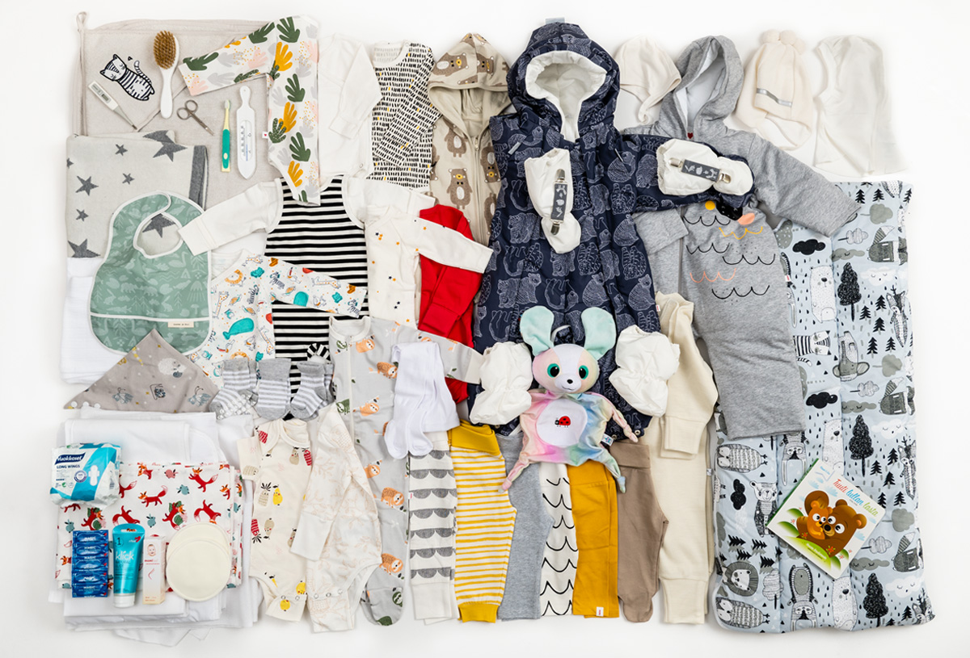
Finland – a welfare system
Äitiyspakkaus “maternity package”
1937 to disadvantaged mothers (to bring them into social security system)
1949 to all mothers

Slide 16
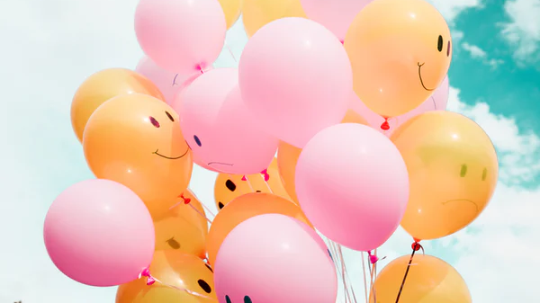
Finland: the happiest country in the world
United Nations World Happiness Report 2021: Finland is the happiest country in the world for the 4th year in a row
Some things that are taken into account in the report: GDP, health, corruption, social networks, feelings of joy or happiness, trust in the society

Slide 17
Finland: the happiest country in the world
According to the World Happiness Report 2021, confidence in institutions was one of factors that supported successful COVID-19 strategies (World Happiness Report 2021, https://happiness-report.s3.amazonaws.com/2021/WHR+21_Ch1.pdf)
“Finland has always ranked very high on the measures of mutual trust that have helped to protect lives and livelihoods during the pandemic.” (In article “In a Lamentable Year, Finland Again is the Happiest Country in the World”, 2021: https://worldhappiness.report/news/in-a-lamentable-year-finland-again-is-the-happiest-country-in-the-world/)
“Trust and the ability to count on others are major supports to life evaluations, especially in the face of crises. To feel that your lost wallet would be returned if found by a police officer, by a neighbour, or a stranger, is estimated to be more important for happiness than income, unemployment, and major health risks.” (World Happiness Report 2021, https://happiness-report.s3.amazonaws.com/2021/WHR+21_Ch1.pdf)

Slide 18
Finland: the happiest country in the world
Happy or just content?
Trust in society: social trust, trust in the government
Welfare system
Safe environments
Healthy life

Slide 19
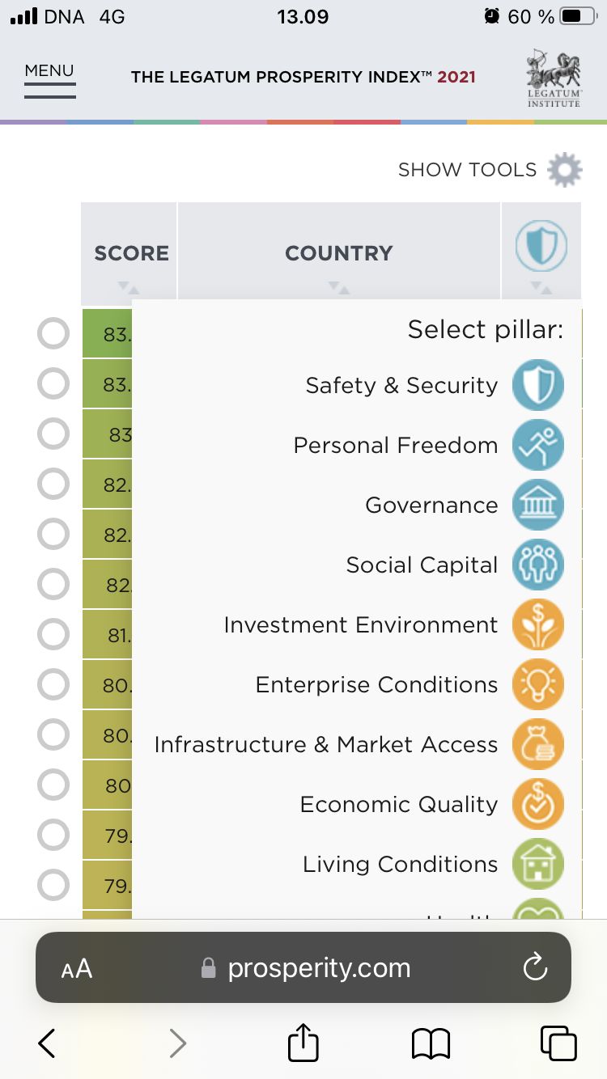
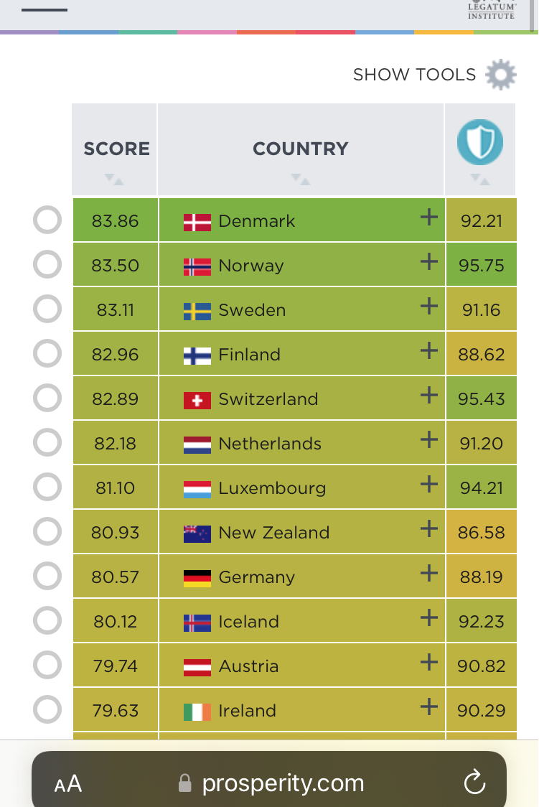
Finland: the happiest country in the world
The Legatum Prosperity Index: A tool that offers insight to how prosperity forms and changes in 167 countries across the world
Group work: See the ranking and the pillars and compare Finland to a few other countries. How is Finland positioned in the ranking based on different pillars? Which pillar(s) do you find (the most) important in a society? Why?
Rankings :: Legatum Prosperity Index 2021

Slide 20
Pre-tasks for lesson 4
Video: How to measure happiness. Watch the video and take notes: Which 5 things enhance happiness? Why Finns are happy?
Read the text about Finnish Education and watch the video Why Finland's schools outperform most others across the developed world.
Take notes: What are the key values in Finnish education system?
+ Start planning your assignment 1 (YOUR TOPIC on OpenLearning)if you haven’t yet.
+ You can also start planning or working on assignment 3: the Cross-Cultural journal

Slide 21
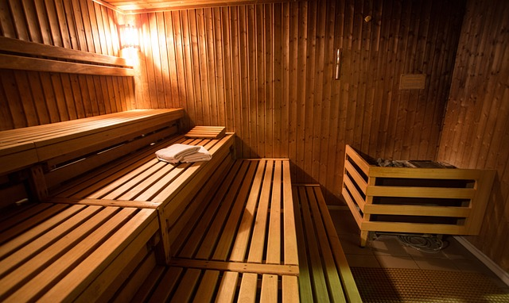
Hyvää loppuviikkoa!
Nähdään taas!

