Slide 1
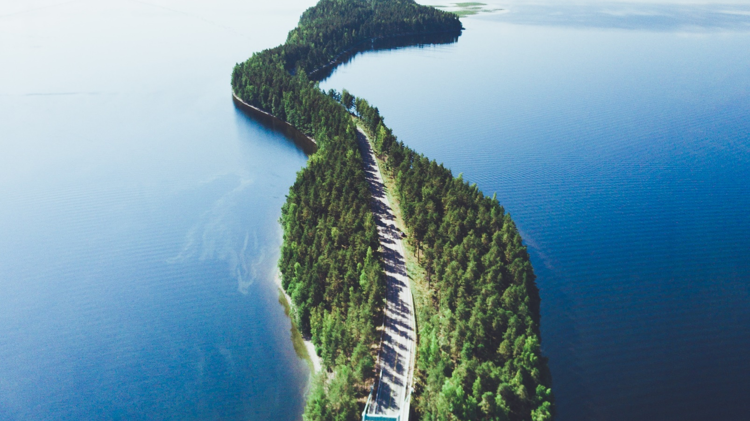
Get to know finland
5.6.2022
12:30-14:00
Anja Keränen

Slide 2
Welcome to the get to know finland coursE!
Let’s get to know each other first:
Moi! Mun nimi on Anja. Mikä sun nimi on?
Hi! My name is Anja. What is your name?
Introduce yourself shortly (try it in Finnish! ☺) and discuss with your group:
Why did you choose Aalto University and/or Finland?
Have you had any experience with Finland before?
What did you know about Finland beforehand?
What are interested in learning in the course?

Slide 3
Course info
Get to Know Finland course will present you with key aspects of the Finnish culture and history.
After the course, you recognize the main characteristics of the Finnish way of life and culture,
and can talk about them as well as have basic knowledge about Finnish nature, history and society.
Lesson 1: History
Lesson 2: Communication and Cultural Competence
Lesson 3: Finnish Society and The Finnish Way of Life
Lesson 4: Finnish Society and Finnish education
Lesson 5: Finland’s creative industries + Presentations
Lesson 6: City tour (self-study, deadline 25.6.2023)
One absence is allowed (more absences → extra assignments). In order to pass the course, 90 % of the tasks must be completed.

Slide 4
Working methods assignments
Assignment 1: Presentations
Due on 19.6.
Assignment 2: Cross-cultural journal
Due on 20.6.
Assignment 3: City tour
Due on 25.6.
Discussion
Lectures
Group work
Pre-tasks / Homework
Extra material
Course page on MyCourses: Syllabus, materials, tasks, announcements

Slide 5
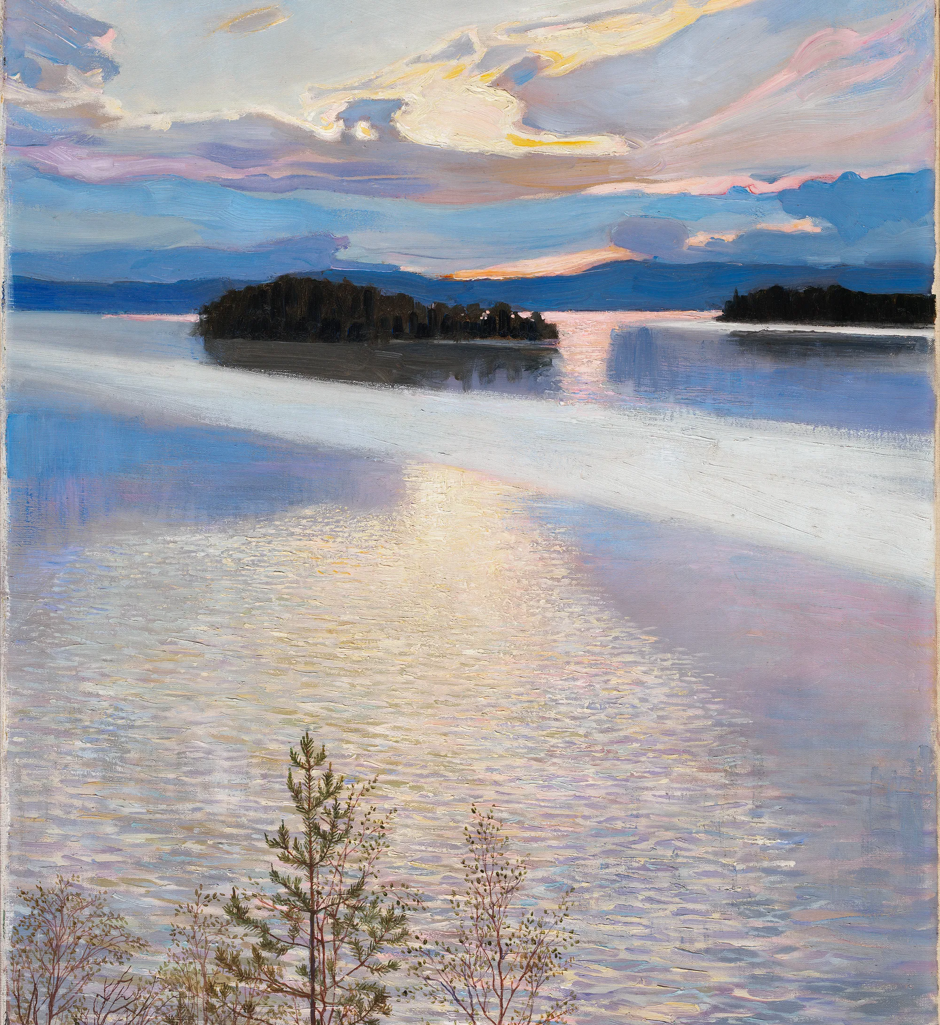
History of finland

Slide 6
Finnish history
Let’s take a quiz: What do you know about Finland’s history? ☺
Let’s see a video: A Super Quick History of Finland and discuss shortly:
1. Is there something you already knew about Finland’s history?
2. If you had time to read the pre-task reading, what did you find especially interesting in Finland’s history?

Slide 7
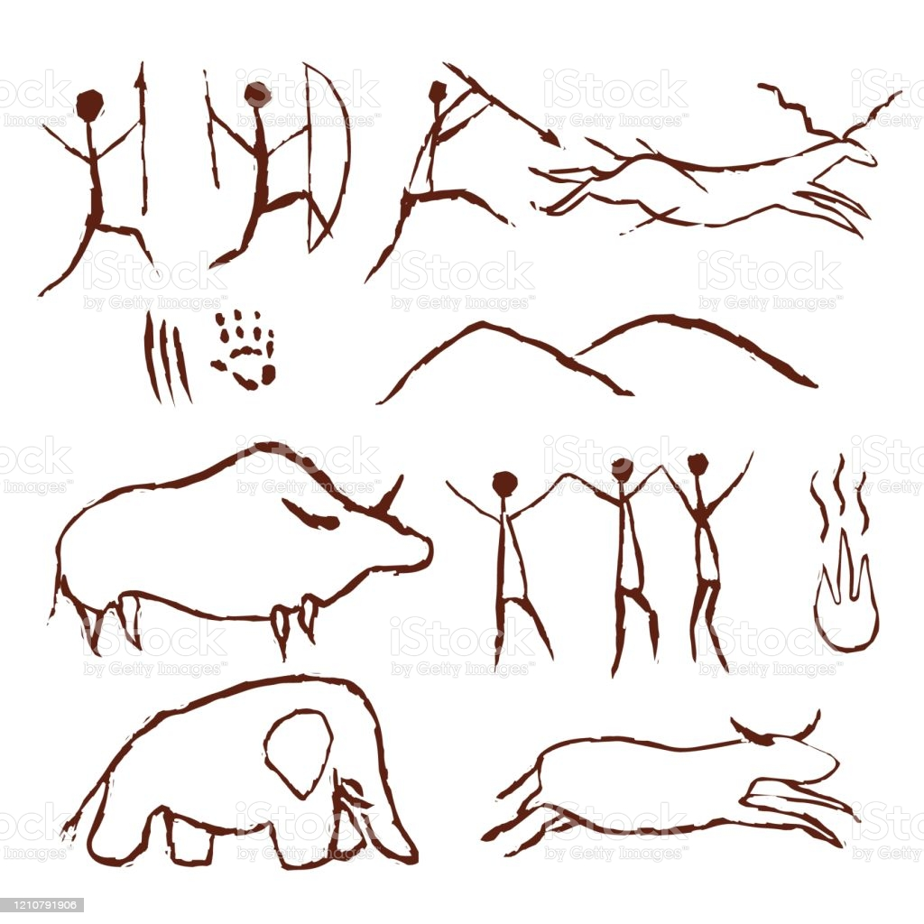
Finnish history in a nutshell
5000 BCE
The settlement of Finland begins.

Slide 8
Finland as part of the Swedish realm
Beginning in the 12th century
Finland becomes a part of the Swedish realm (for 600 years)
1548
The era of reformation: In 1548, the New testament was published in Finnish. Due to reformation, the foundation of literary Finnish was created.
Who is Mikael Agricola (1510–1557)?
Founder of literary Finnish. Translated and wrote the first books in Finnish language and developed standard written form of Finnish. Mikael Agricola has his own flag day on April 9, which is also the Day of the Finnish Language.

Slide 9
Finland as a grand duchy of Russia
1809
Finland becomes a part of Russia due to a lost war which ends the time of Swedish realm in Finland.
1849
The National epic Kalevala (compiled by Elias Lönnrot) is published. Elias Lönnrot travelled around Finland, in Karelia and eastern parts of Finland, and collected poems for the national epic. Kalevala has its own flag day on February 28, which is also the Day of Finnish Culture.
1866
A national school system is set up.
What event marks the year 1906?
Finland becomes the first country to grant full political rights to women which means that women were able to both vote and run for office.

Slide 10
Independent Finland
1917
The Russian empire collapses and Finland gains independence from Russia.
1918
Civil war that lasts from January until May. The war divided the country into two camps (“the white” and “the red”) and left deep wounds in the nation for decades.
1939-44
The second world war and two wars in Finland: The Winter war in 1939–1940 and the Continuation war in 1941–1944, both against the Soviet Union. After the war, Finland lost areas to the Soviet Union, and more than 400,000 had to be resettled. Finland remained its independency and remained a democracy.

Slide 11
Independent Finland
1952
Helsinki hosts Summer Olympics.
1991
The world’s first GSM call is made in Finland. In the upcoming years, the Finnish company Nokia would shape the world of cell phones.
1995
Finland joins the European Union.
Future of Finland?

Slide 12
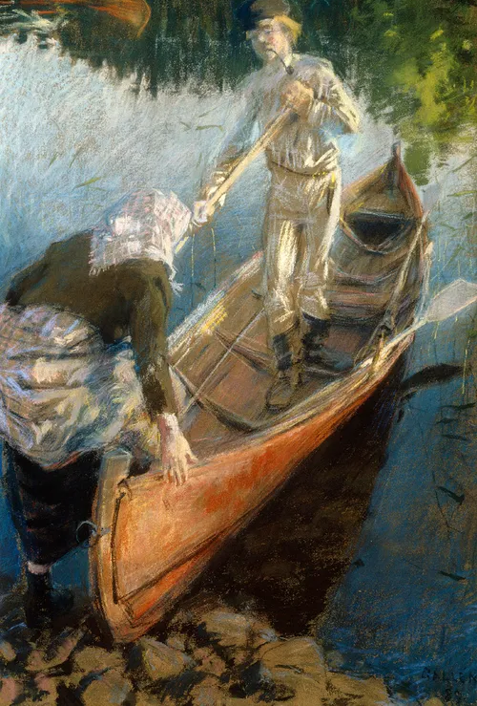
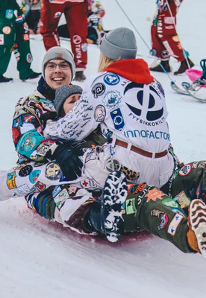
Forming the finnish identity
The first steps towards independence were taken (and drawn and written) already in the 1800s
Nationalist movements spread across Europe
Russia granted the autonomous Finland more rights
Artists and writers began to shape the Finnish “identity” – inspiration from nationalism and romanticism
  Elements: history, myths, ideologies
  From “humble and hard-working Finn” to shifting, multicultural, and personal identities

Slide 13
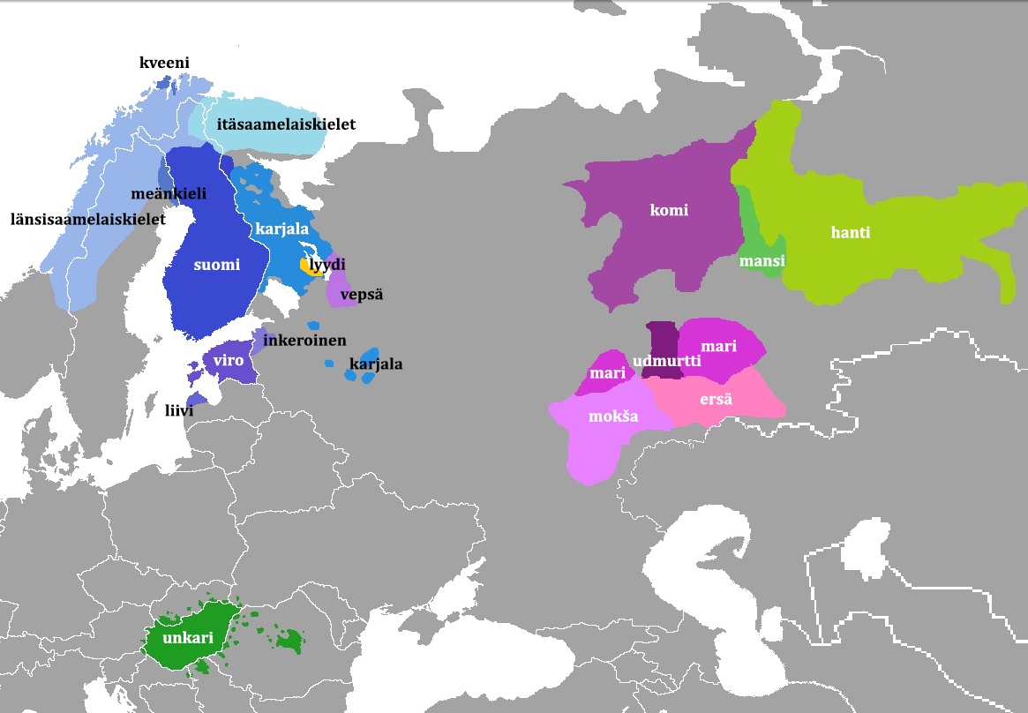
Finno-ugric languages
Finnish belongs to Finno-Ugric language family
Approximately 40 languages and 20-25 million speakers

Slide 14
History of finnish language
Finnish language has its roots in ancestral (reconstructed) Proto-Uralic language from apr. 6000 years ago
Finnish language has layers from thousands of years ago to this day
The oldest vocabulary often reflects the environment and what was needed to say out loud
  Nature and seasons: joki, jää, koivu, suvi, syksy
  Body parts: käsi, jalka, pää
  Verbs: mennä, nähdä
Loan words are evidences of interaction – and the nature of interaction
  For example some Germanic loans tell of trade: kauppa, kulta, raha, valta
  Many (newer) loan words are quite recognizable: poliisi, pankki, ambulanssi, kahvi
  References: Sanojen alkuperästä - Kotimaisten kielten keskus (kotus.fi); Suomen kielen virstanpylväät | Kulttuuri | yle.fi

Slide 15
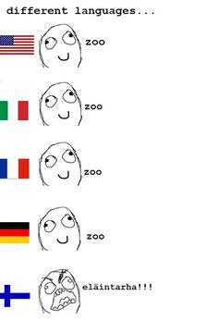
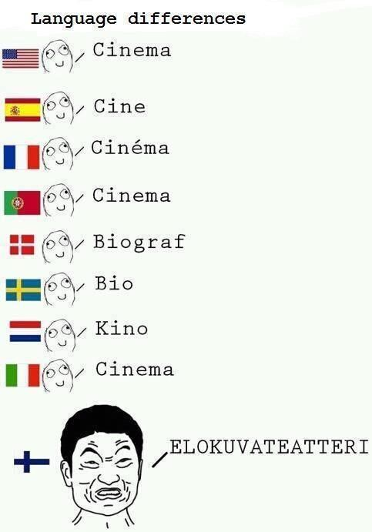
Some loan words below…
kahvi
poliisi
ambulanssi
tomaatti
banaani
appelsiini
teatteri
taksi
metro
auto
And somewhat more original vocab on right and left ☺

Slide 16
Finnish history street names, places and people in helsinki
Group work: with your group, find out some facts about the people behind the street names and places in Helsinki. Write at least 5 things about them in Padlet . Also find out the location of that street / place in Helsinki e.g. by using Google Maps.
Link to Padlet: Finnish names (padlet.com)
1 street: Lönnrotinkatu person: Elias Lönnrot
2 street: Mannerheimintie person: Carl Gustav Emil Mannerheim
3 street: Aleksis Kiven katu person: Aleksis Kivi
4 street: Minna Canthin katu person: Minna Canth
5 street: Sibeliuksenkatu person: Jean Sibelius
6 street: Urho Kekkosen katu person: Urho Kekkonen
7 street: Alvar Aallon katu person: Alvar Aalto
8 park: Tarja Halosen puisto person: Tarja Halonen
9 park: Tove Janssonin puisto person: Tove Jansson
10 square: Elielinaukio person: Eliel Saarinen

Slide 17
Pre-tasks for lesson 2
1. Read the articles
1) What are you doing here?
2) Finnish silence can be golden
2. Watch the video about Cross cultural communication
+ Want to know more about Finland’s history? See lesson 1 extra material in OpenLearning!

Slide 18
1. Cultural dimension test (optional)
Part 1:
a) Do the Geerd Hofstede's Cultural Dimension test online. Read the descriptions of the dimensions first!
b) Choose your country and see its cultural dimensions. Compare a few dimensions such as masculinity and power distance in your country and Finland. Write down a few notes: Do you agree or disagree with the descriptions of your country. Why?
Part 2:
a) See Eringa et al. (2015) article How relevant are Hofstede’s dimensions for inter-cultural studies? A replication of Hofstede’s research among current international business students. You don’t have to read the whole article but instead see the chapter Criticism p. 187–188.
b) Write down a few notes and prepare to discuss in class: After reading the chapter in the article by Eringa et al. (2015), do you see the test differently? You can think of e.g. the dimensions and your result. Do you think Hofstede’s model is still a way to depict different cultures? Why, why not?

