Slide 1
PRODUCT SUSTAINABILITY

Slide 2
PRESENTATIONS
Dos
Sticking in the given schedule (= practicing)
Having & showing clear structure
Donts
Avoid any extra material: use text & visuals, which support your message
Avoid reading directly from paper / phone (=practice)

Slide 3
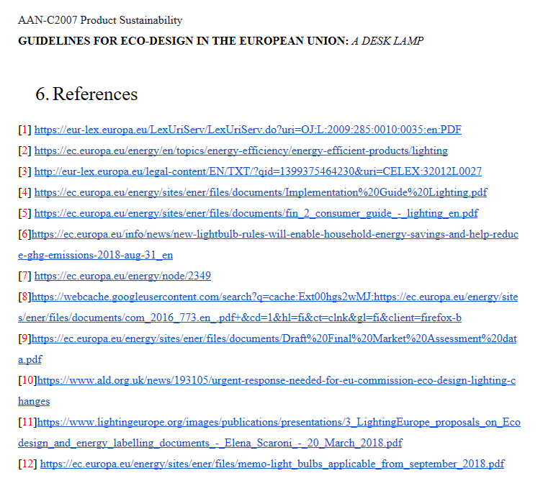
REPORTS
…(ECCP) as one of the products with the highest potential for cost-effective reduction of greenhouse gas emissions (CO₂) [1]. It was estimated that energy efficient lighting products have a potential to reduce CO₂ emissions in Europe by 12 million tonnes and save energy to power nearly 11 million households [2]. Therefore, a set of targets for energy efficiency related to lighting and other products was introduced in the Energy Efficiency Directive adopted by the European Union Commision [3]…
Dos
Present your team and task title at the first page
Put contents and reference list at separate pages (2nd and the last one)
Connect references in the relevant points in the text
State clearly if the studied criteria(s) can / can not be applied for your product
Donts
Do not use figures/tables without linking them clearly in text
Do not copy-paste text as such

